Slide 1
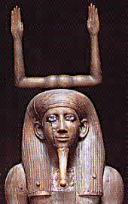
Ancient Egyptians Belief
“The ancient Egyptians did not make the sharp distinction between body
and soul that is basic to many religions. Rather, they believed that
from birth a person was accompanied by a kind of other self, the ka
(life force), which, on the death of the body, could inhabit the corpse
and live on” Kleiner (2010)
This belief was expressed in the architecture of the ancient Egyptians.

Slide 2
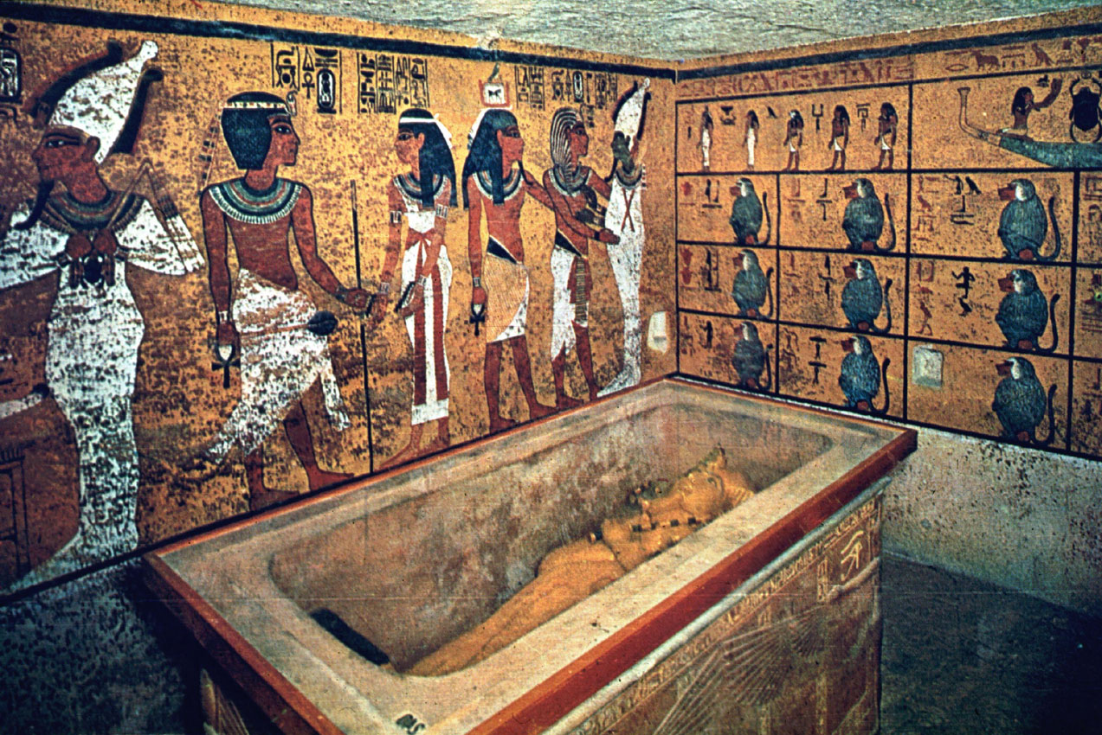
Egyptians belief and Architecture
The ancient Egyptians believed that mummification was one of the requirements for immortality. They also believed that certain necessities such as food, drink, clothing and furniture had to be provided in the burial chambers.
Taking all this into consideration, their burial chambers of the Egyptians had some interesting and unique figures.
- Their burial chambers were specially designed to provide the dead with the necessities mentioned.

Slide 3
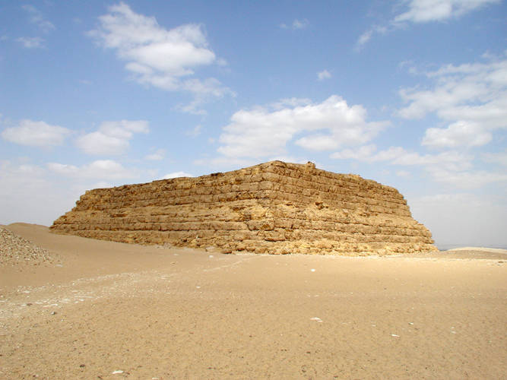
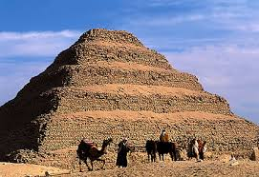
Ancient Egyptian burial chambers
Mastaba
The step pyramid

Slide 4
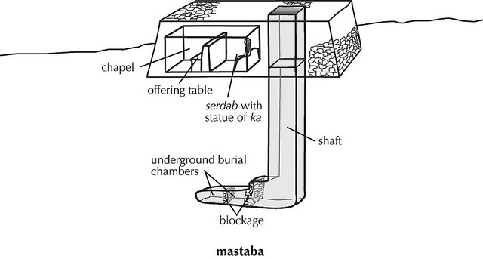
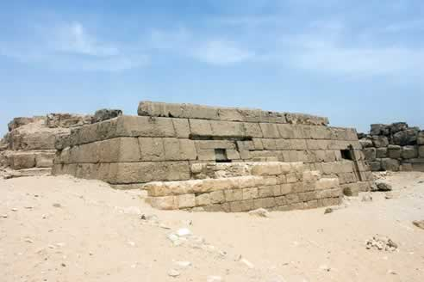
Mastaba
A mastaba is a flat roofed rectangular Egyptian tomb which is mostly constructed out of mud bricks or stone
Egyptians belief was highly expressed in the design of the Mastaba
This is the most ancient burial chambers in ancient Egypt.
The design itself protects the dead bodies from outside intruders.
Statue of ka is seen inside the mastaba itself with an offering table and chapel.
The structure is camouflaged with the surrounding from the exterior, emphasizing privacy.

Slide 5
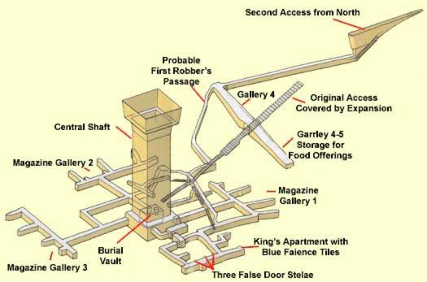
The step pyramid
Step pyramid was designed by Imhotep who is first known architect.
The step pyramid is more complicated compared to the Mastaba.
Egyptians kings and queens are believed to be buried in these chambers.
Includes 4 magazine galleries.
The original access itself is covered by expansion
An apartment for the king with blue faience tiles.

Slide 6
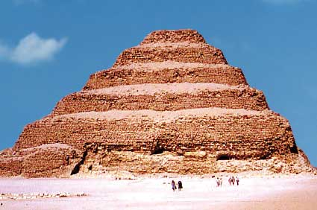
Also includes 3 false door stelae – To confuse the intruders and robbers.
It would be fair to conclude that the step pyramid offers more protection to the dead body compared to the mastaba.

Slide 7
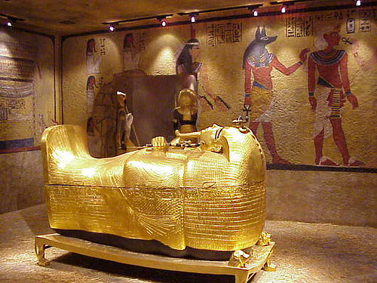
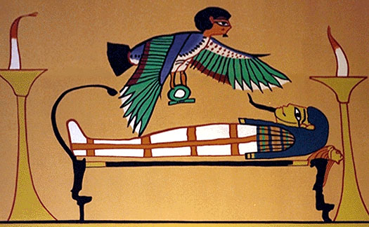
Conclusion
The step pyramid and the Mastaba’s were the two common burial chambers.
The design of the burial chambers itself offers protection for the dead body.
Its designed to provide the dead with basic necessities.
Ancient Egyptians were masters in expressing their beliefs in their architecture.

Slide 8
Reference
Kleiner, Fred. (2010). Gardners Art Through the Ages Vol 1. Gardners Books.
Alamy. (2014). Awibra Hor with ka headdress representing creative life-force of the king, Head of wooden statue from Dahshur, 13th Dynasty. Retrieved from http://www.alamy.com
Chris Morton blogspot . (2013). Egyptian tombs – Initial thoughts. Retrieved from http://chrismorton3d.blogspot.com/2013/03/while-i-was-in-college-i-was-given-task.html
Stalcup. (2001). Ancient Egyptian Civilization. San Diego, CA. Greenhaven Press.

