Slide 1
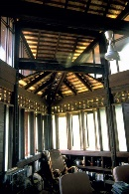
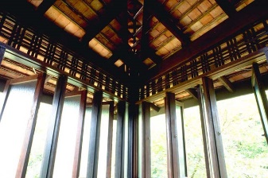
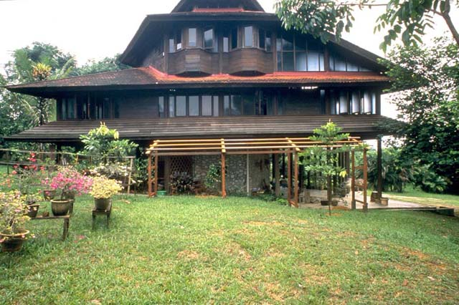
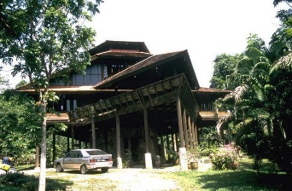
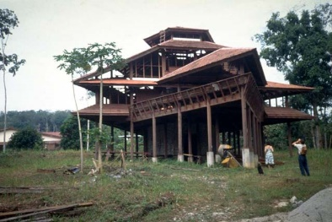
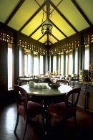
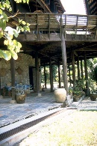
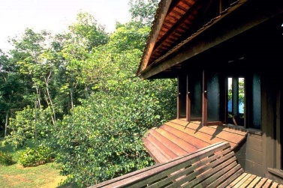
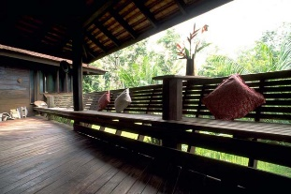
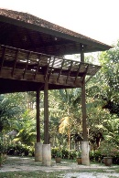
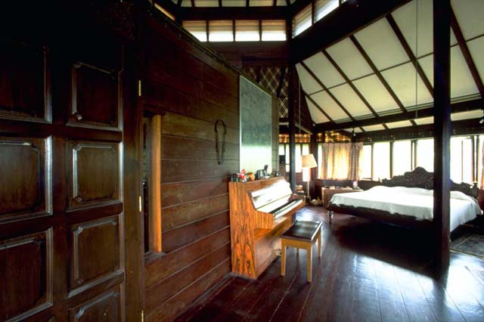
Usage of Malay Traditional Design Elements
As An Approach To Achieve Environmental
Sustainability in Salinger House, District of Bamgi
Naajid Naseem 0311649

Slide 2
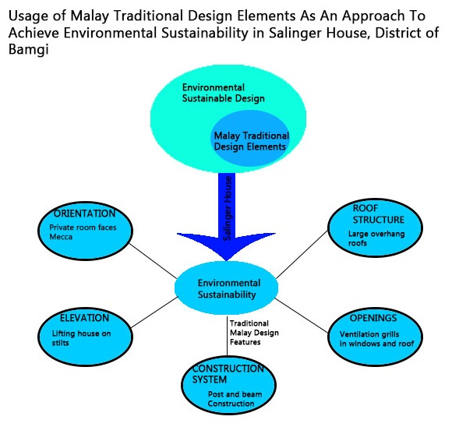

Slide 3
Research Questions
Research Questions
1. What are Malay traditional design elements
2. How do we achieve environmental sustainability in a design
3. What are Malay traditional design elements used in Salinger House and how does it contribute to achieve environmental Sustainability?
OBJECTIVE
- To find whether the Malay traditional design elements used in Salinger house, contribute to achieve environmental sustainability

Slide 4
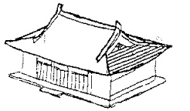
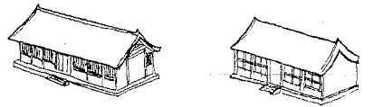
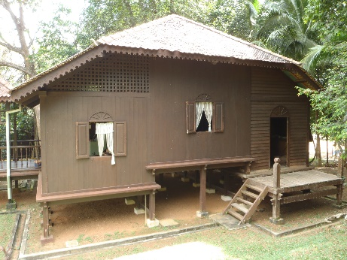
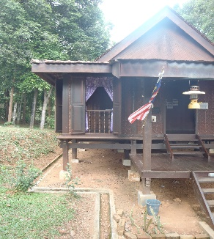
What are Malay Traditional design elements?
Tradition, can an be defined as transmission of customs or beliefs from generation to generation
Therefore, traditional Malay design elements are the beliefs or features in terms of design which has been passed on from generation to generation
Relies on religion, climate and the culture of the place.
Malay traditional houses can be classified by their roof shapes
Bumbung Panjang -Bumbung Lima (has a hipped roof) -Bumbung Perak (has a gambrel roof)
Bumbung Limas (has a pyramidal roof)

Slide 5
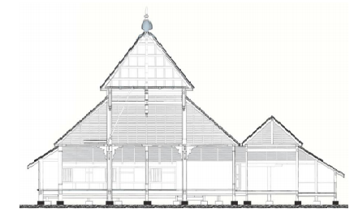
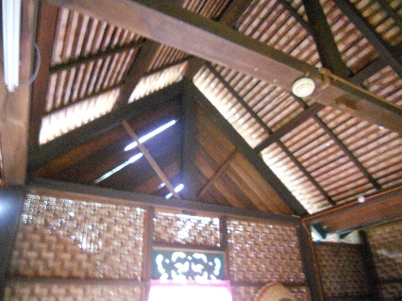
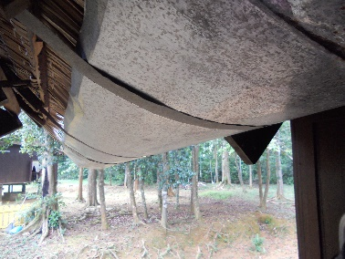
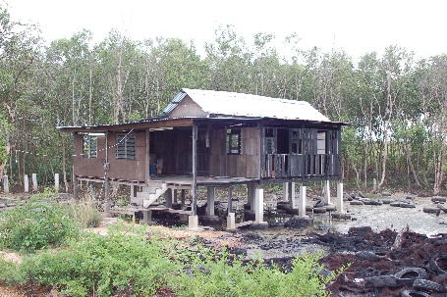
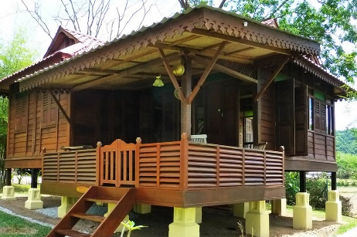
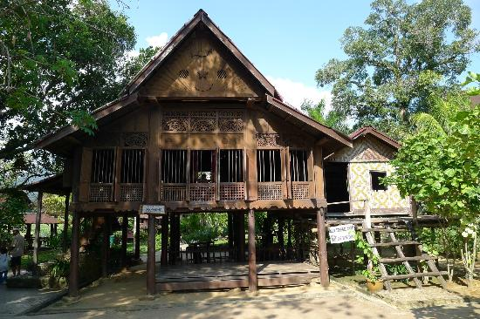
What are Malay Traditional design elements?
Openings to allow natural ventilation
Post and beam construction
Private spaces to face Mecca
Drainage system
Open plan
Using Metal plate
Kampung Laut Old Mosque, Nilam Puri
House raised on slits
Large overhanging roof
Mahsuri
Mausoleum,
Langkawi
Kampung House in Kudala Kedah
Reconstructed Malay Kampung House, Sunset valley, Langkawi

Slide 6
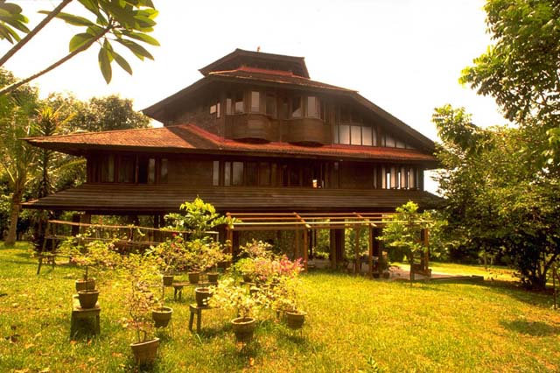
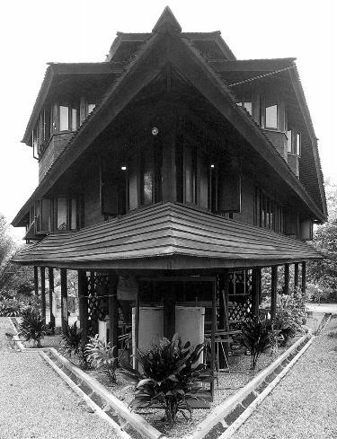
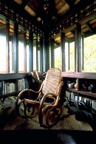
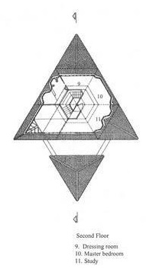
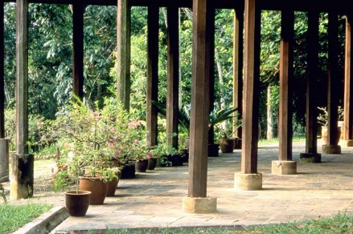
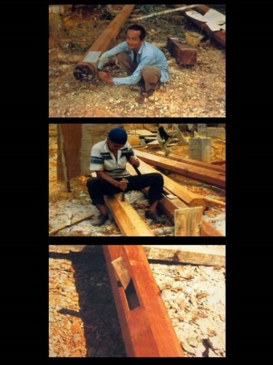
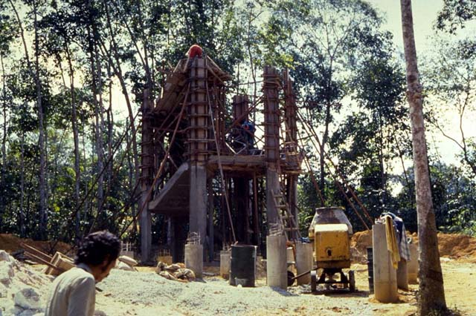

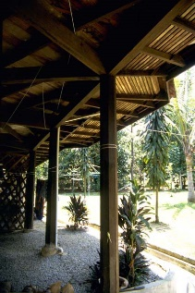
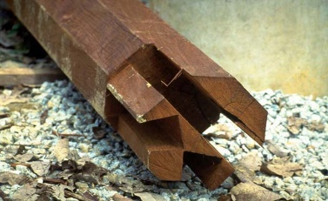
What are Malay Traditional Design Elements used in Salinger House?
Openings
Roof Structure
A lot of openings, and cross ventilation grills
Large overhanging roof
Construction System and Material
Open Plan and Orientation
Elevation
Open plan
Private spaces to face Mecca
House raised on
stilts
Uses post and beam timber structure
Used timber dowels and traditional joining techniques

Slide 7
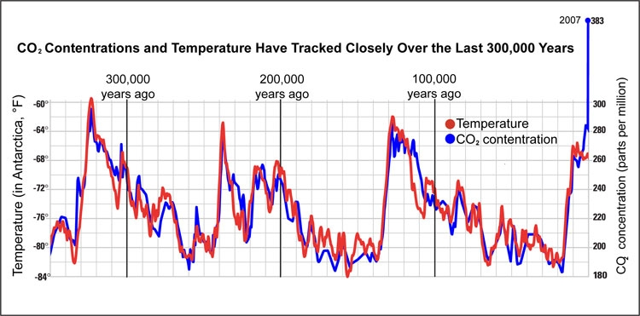
What is Environmental Sustainability ?
Environmental sustainability could be defined as a condition of balance and
interconnectedness that allows human society to satisfy its needs while neither exceeding the capacity of its supporting ecosystems to continue to regenerate the services necessary nor by our actions diminishing biological diversity”. (Morelli, 2011)
It defines how we should study and protect ecosystems, air quality, integrity and sustainability of our resources and focusing on the elements that place stress on the environment
Why do we need Environmental Sustainability?
Environmental protection is the third pillar of sustainability and is the primary concern of the future of humanity.
Buildings account for 40% of energy use
worldwide
Building operations consume more than 2/3
of all electricity
Energy used during its lifetime causes as
much as 90% of environmental impacts
from buildings

Slide 8
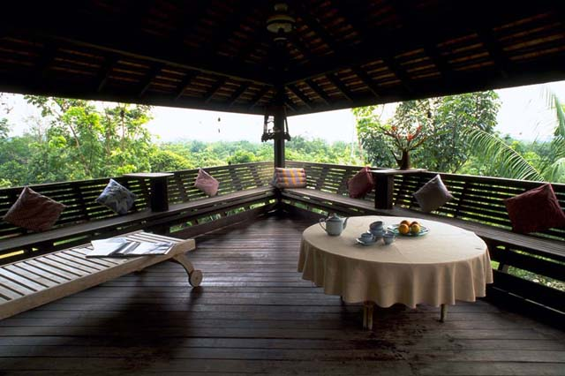
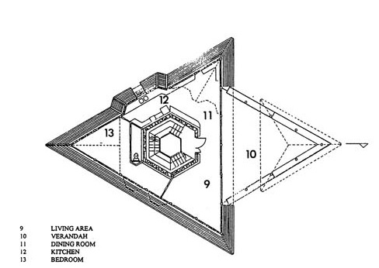
How do the Malay traditional elements in Salinger House contribute to achieve Environment Sustainability ? (Analysis)
Orientation
Mecca is 292.54 degrees north of Malaysia
The geometry of the house is oriented in such a way that the private spaces face Mecca and the public spaces catch the prevailing wind

Slide 9
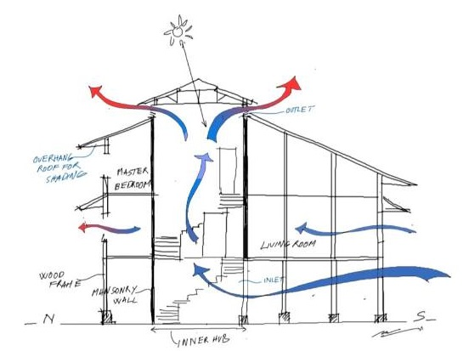

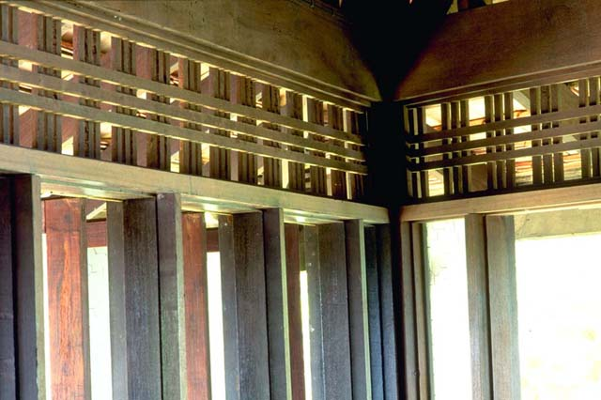
Open Plan and Openings
House is designed with an open plan and a lot of openings to maximize cross ventilation
Cross ventilation grills over the windows and in high points in the roof. Air is thus pulled through the whole space of the house
(Diagram showing cross ventilation)

Slide 10

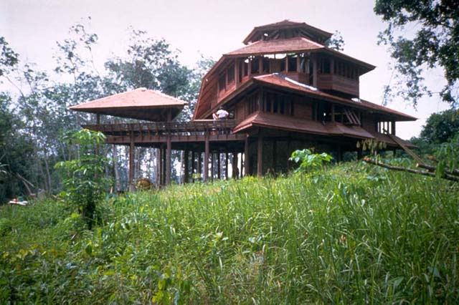
Elevation
The house is raised on stilts to reduce the impact of structure on to the land and environment
The house is on a high elevation to reduce water run-off through the building during the monsoon rains.
No major earthwork were done, the natural contours of the site were kept, and the topsoil was preserved.
The landscaping around the house was kept as natural and as undisturbed as possible.

Slide 11

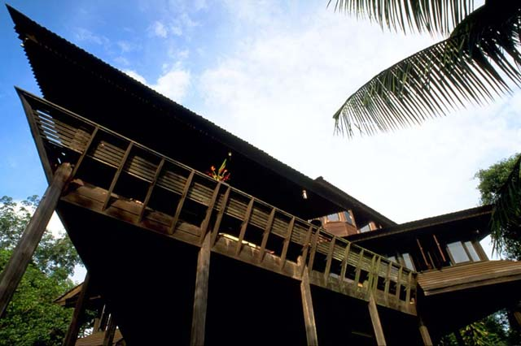
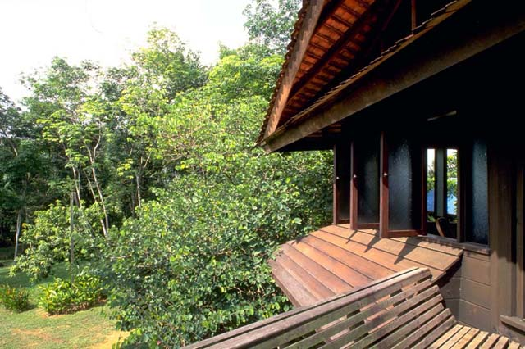
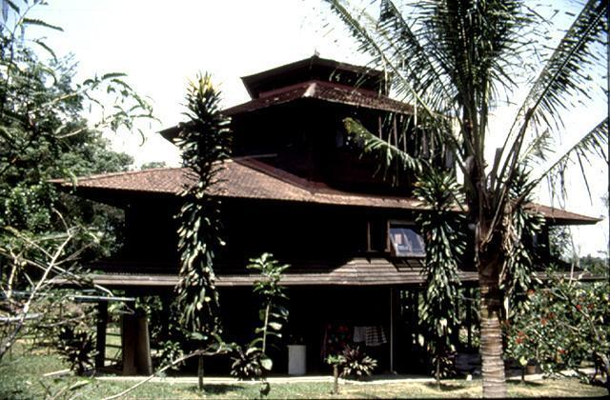
Roof Structure
The large overhanging roof ensures solar protection for the walls and protection from the monsoon rains.
The roof is extended to shade the veranda.

Slide 12
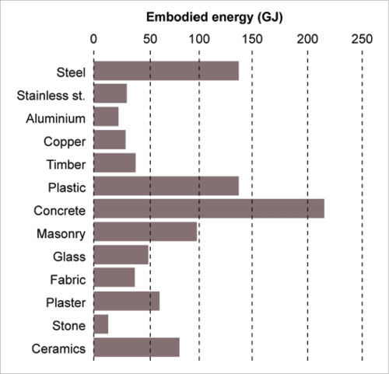
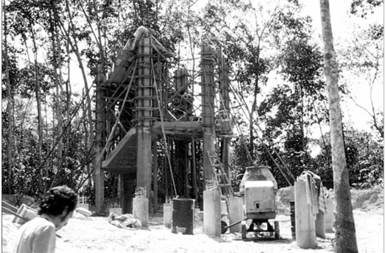
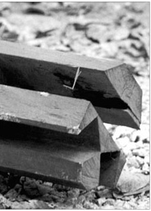
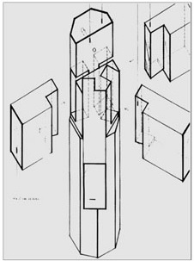

Construction System and Materials
The timber used is a local hardwood called chengal. (a very dense
timber that is highly resistant to water and termites. It is known
traditionally as the king of the wood)
No metal connections as all joints are made of timber. Where required, timber dowels and traditional joining techniques were used throughout the house.
The building utilizes the traditional Malay construction system using a post and beam timber structure which enables Lightweight construction
Lightweight construction materials, are easy to store and transport, thereby reducing their environmental footprint.
Less embodied energy compared to other alternative methods.

Slide 13
References
Alamuddin, H. (1997). Salinger Residence. Kuala Lampur .
Authority, B. a. (2012). Code for Environmental Sustainability of Buildings. Code for Environmental Sustainability of Buildings, 248.
Malaysia architecture. (2012, February 11). Retrieved from msiaarch.blogspot.my: http://msiaarch.blogspot.my/2012/02/salinger-residence.html
Morelli, J. (2011). Environmental Sustainability: A Definition for Environmental Professionals. Journal of Environmental Sustainability, 8.
Kibert, C. (2008). Sustainable construction: Green building design and delivery (2nd ed.). Hoboken, N.J.: John Wiley & Sons.
SGH Carpet. (n.d.). Retrieved October 5, 2015, from http://www.tufts.edu/programs/sustainability/SGH/recycledmaterials.htm
Naajid Naseem
(0311649)

